Slide 1
Verity Platform
Users
Applications
Users
Applications
Verity Governance Layer
Verity Reputation Layer
Verity Collaboration Layer
Agents
Content
Communities

Slide 2
Verity Reputation Layer
Values-Based Reputation
Skills-Based
Reputation
Contribution-Based
Reputation
Values Measurement
Trust Graph
Core Values
Value Tags
Value Scores
Affinity Score
Skills Measurement
Skill Tags
Skill Tokens
Skill Tokens
Authority Tokens
Verity Cleary Tokens
Work Measurement
Utility Function Standard
Specialized Utility
Contribution Tokens
Algorithms
EIGENTRUST
EIGENTRUST++
Relative Rank
Value Rank
Contests & Campaigns
Metrics Contests
Consensus Contests
Novice Matches
Contests & Campaigns
Metrics Contests
Consensus Contests
Novice Matches
Skill Types
Guild Skills
Shared Skills
Organizational Skills
Reputation and Ratings Standard
Traits
Ratings and Attestations
Instances
Classes

Slide 3
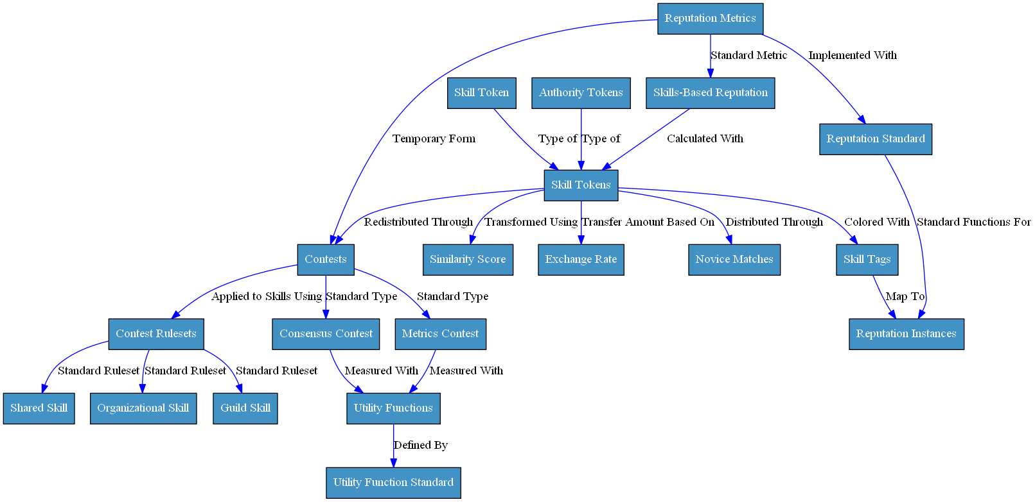
Skills-Based Reputation Flowchart

Slide 4
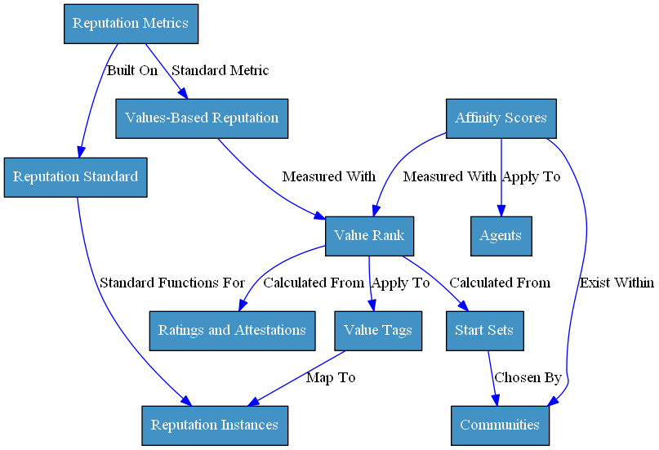
Values-Based Reputation Flowchart

Slide 5
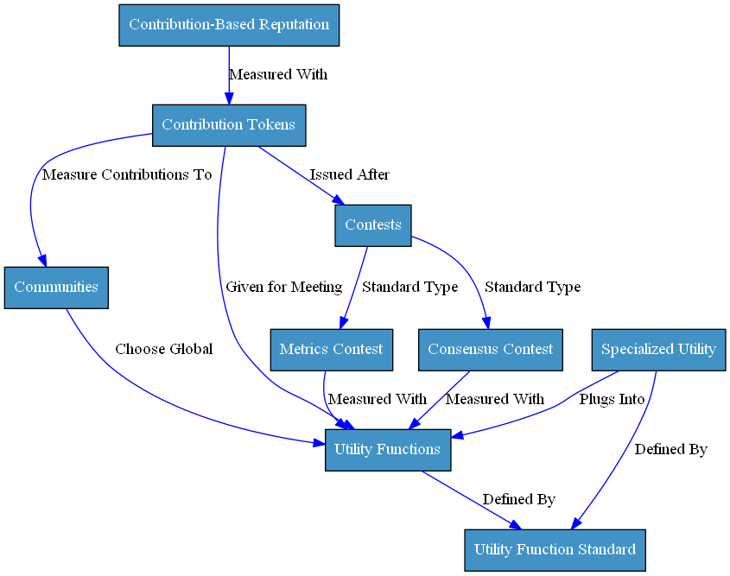
Contribution-Based Reputation Flowchart

Slide 6
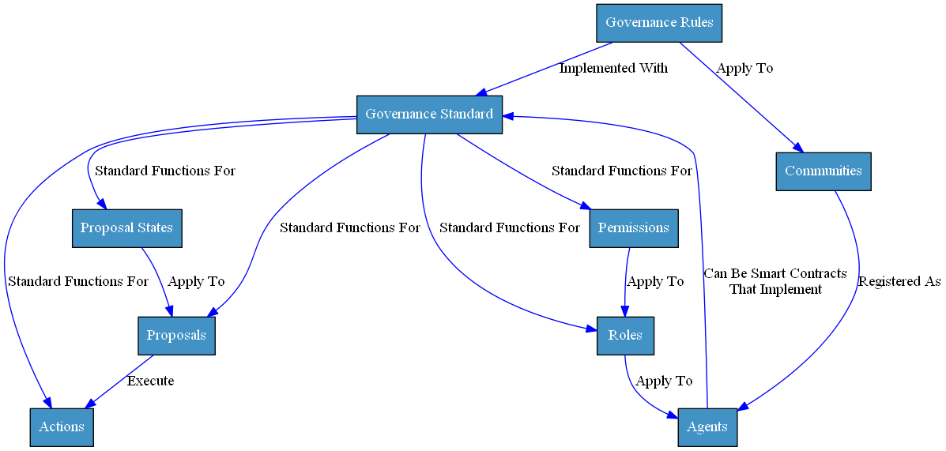
Governance Standard Flowchart

Slide 7
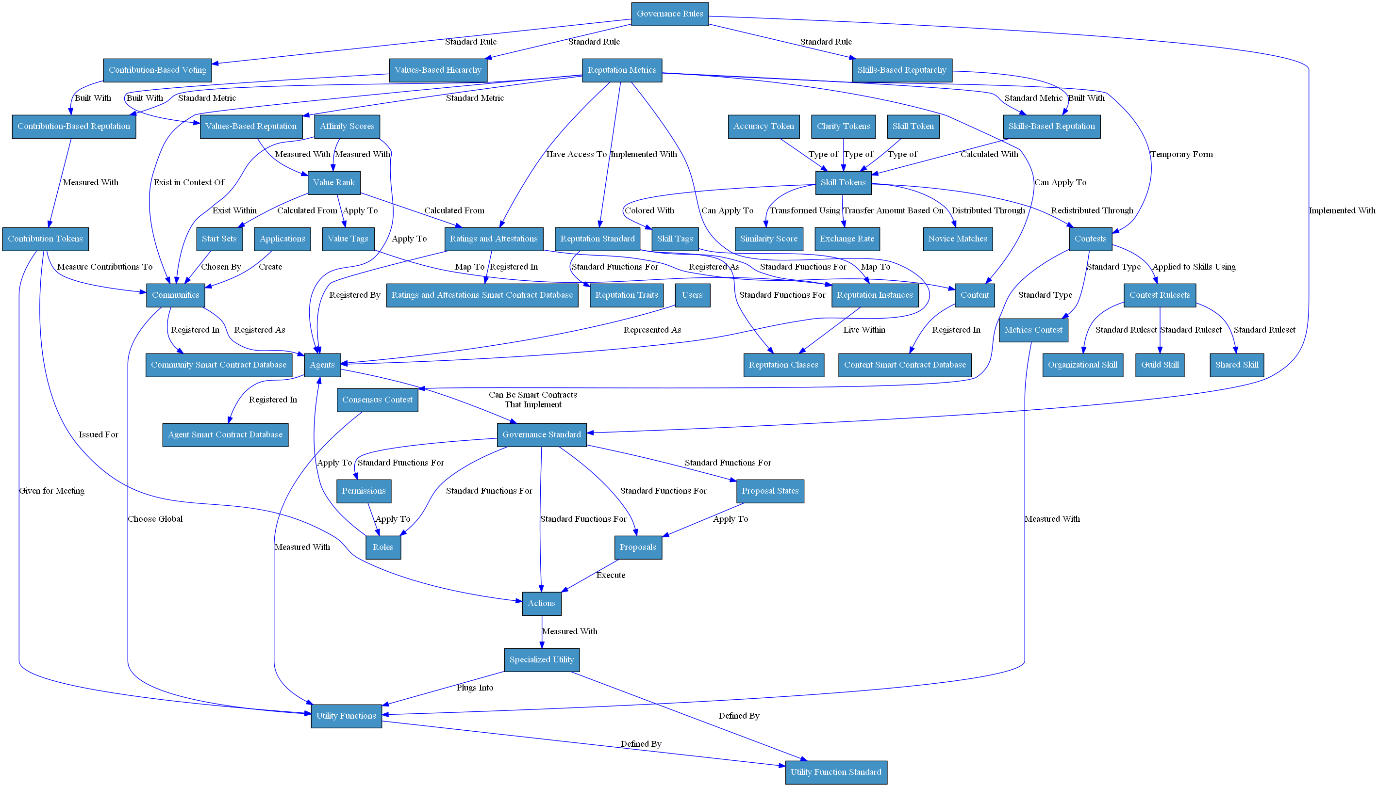
Verity Architecture Flowchart

Slide 8
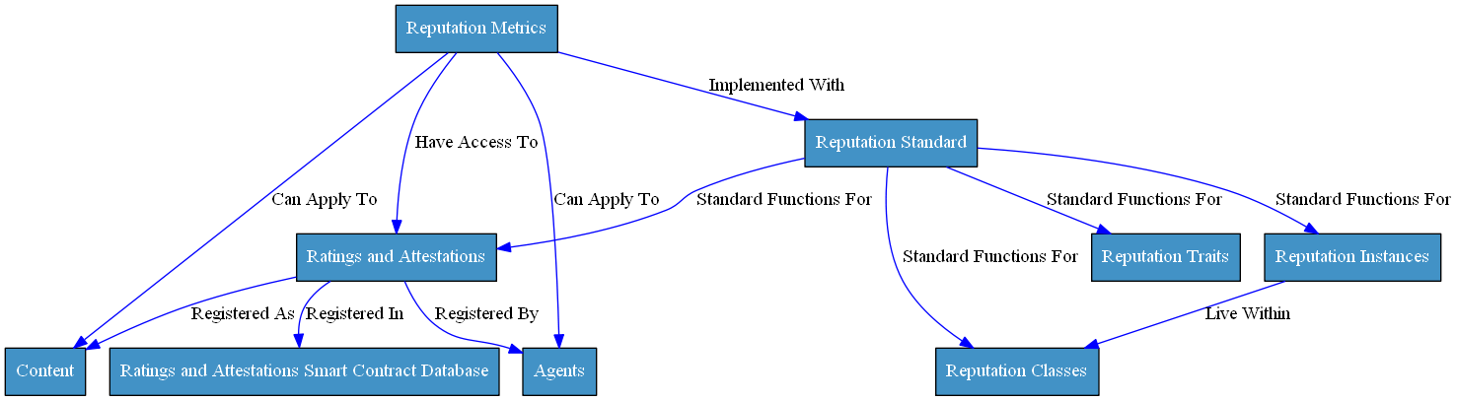
Reputation Standard Flowchart

Slide 9
Verity Governance Layer
VerityDAO
Global Governance
Defines Global Rules
Runs Central Protocol
Oversees Ecosystem Growth and Maintenance
Values-Based Hierarchy
Contribution-Weighted Voting
Skills-Based Reputarchy
Hierarchical Structure
Built on Values-Based Rep
Defined Hierarchy
Superiors Choose Start-Set
Automatic Promotions
Capitalistic Structure
Built on Contribution Rep
Voting Mechanism
Votes Weighted By Tokens
Optional Decay Over Time
Meritocratic Structure
Built on Skills-Based Rep
Community Utility Function
Decisions Made in Contests
Contractors Hired
Governance Standard
Actions
Proposals
Roles
Permissions

Slide 10
Verity Collaboration Layer
Agents
Content
Communities
Entity That Can Act in Platform
Public and Private Key
Tracked in Single Smart Contract
Optionally Linked to External Identity Layer
Non-Active Entity That Can Be Rated or Acted Upon
Immutable Piece of Data
Mutable Piece of Data
Immutable Hash/Link Pair
Mutable Agent/Link Pair
Group of Agents with Common Aims
Fluid Creation Process
Tracked in Single Smart Contract
Defined With Governance and Reputation

